Slide 1
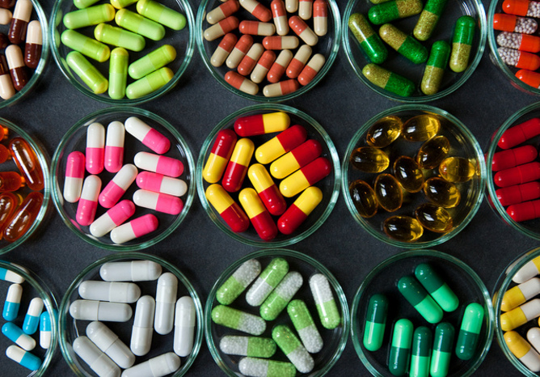
Ontology-based Expert System for a Generic Drug Production of Pharmaceutical Dosage Forms
Project Proposal presentation
Wednesday, March 12, 2014
By
Mr. Narongrit Saisuwan 542115017
Mr. Panupak Wichaidit 542115047

Slide 2
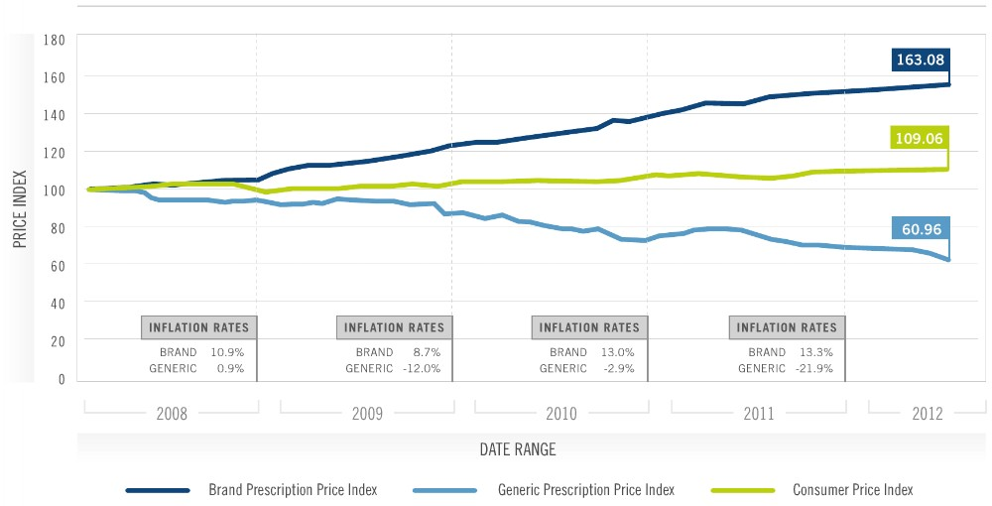
Drug Patent Production
Use for protecting a drug imitation.
Protected by patent protection is called as The Original Drug
The Original Drug is too expensive!!!

Slide 3
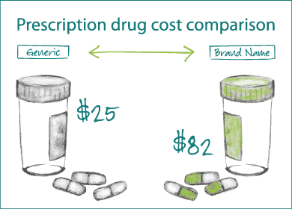
Solve a original drug price problem
Reformulate the original drugs as a generic form

Slide 4
Solve a original drug price problem
How to reformulate a original drug as a generic form??
Original Drug
Don’t know manufacturing
Don’t know excipients
Reformulate
Find manufacturing similar with an original drug
Find excipients similar with an original drug.
Generic Drug
Manufacturing and excipient similar with Original
The result and Dissolution profile similar with Original Drug
Know the result and Dissolution profile
Compare a result and Dissolution profile with the original drug
Product It!!

Slide 5
A drug reformulation problem
Time – consuming
Quality
Not a simple task
Missing reformulate information
How to resolve it?

Slide 6
Business Review : Expert System
Use an expert system for reformulate an original drug as a generic form
Use the expert system
Original Drug
Don’t know manufacturing
Don’t know excipients
Reformulate
Find manufacturing similar with an original drug
Find excipients similar with an original drug.
Generic Drug
Manufacturing and excipient similar with Original
The result and Dissolution profile similar with Original Drug
Know the result and Dissolution profile
Compare a result and Dissolution profile with the original drug
Product It!!

Slide 7
Business Review: OXPIRT SYSTEM
OXPIRT SYSTEM
One of expert system.
Use an inference engine(rule base) to reformulate an original drug
Pharmaceutical Tablet Production Ontology (PTPO)

Slide 8
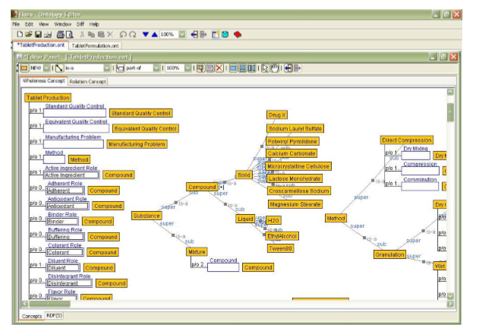
Business Review
Pro
Reduce a statement of the process to find a generic drug manufacturing.
Help to practice drugs producing.
Con
Not support a smart phone device or a tablet computer.
Only reformulate original drugs as a tablet dosage form.
Only use rule base system to reformulate original drug.
Pharmaceutical Tablet Production Ontology (PTPO)

Slide 9
Project Overview
Ontology-based Expert System for a Generic Drug Production of Pharmaceutical Dosage Forms

Slide 10
Project Overview
One of Expert system.
Developed on tablet computer.
Helping a reformulate original drugs as a generic version.
Use case base –reasoning, rule base and hybrid system(Additional function)
Pharmaceutical Dosage Form Production Ontology(PDPO)

Slide 11
Technology review: Rule base system review
Rule base system

Slide 12

Technology review:Rule base system review
JESS
One of rule base engine
Use for developing rule base system
Base on Java language
small, light and one of fastest engine.

Slide 13
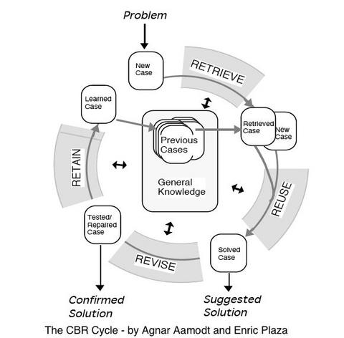
Technology review : Case base reasoning review

Slide 14

Technology review
Base on Java language
One of case base reasoning framework

Slide 15
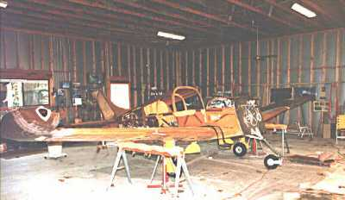

Technology review
Case base – reasoning system example
CLAVIER
Selector

Slide 16




Other Technology

Slide 17
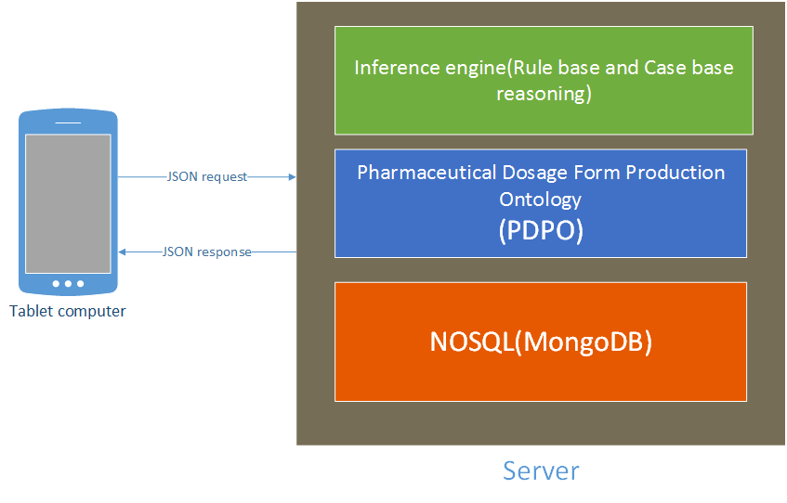
System Architecture

Slide 18
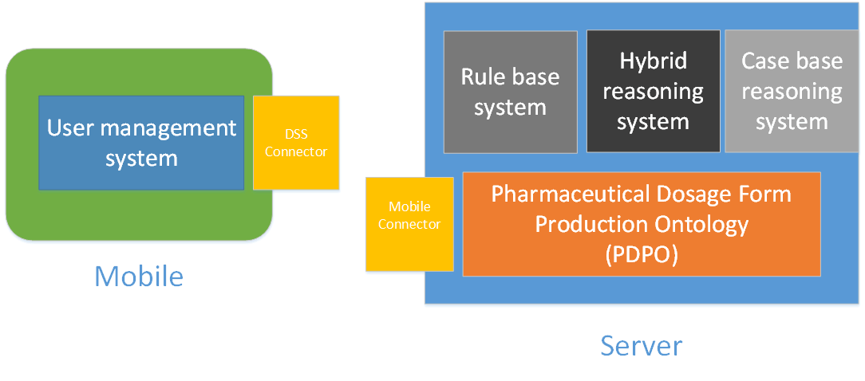
System Architecture overview

Slide 19
Deliverables
Progress 1
Feature 2 : Rule base system
Feature 5 : Pharmaceutical Dosage Form Production Ontology (PDPO)
Feature 7 : Mobile connector
Progress 2
Feature 1 : User management system
Feature 3 : Case base reasoning system
Feature 6 : DSS connection system
Progress 3
Feature 4 : Hybrid reasoning system

Slide 20
Limit
• The user requires a Tablet computer and internet connection.
• Ontology-based Expert System for a Generic Drug Production of Pharmaceutical Dosage Forms is appropriated with a person who has a pharmacy knowledge.

Slide 21
Schedule and Milestone
Milestone | Task | Milestone Criteria | Planned date
1 | Proposal | Topic defined | February
2 | Proposal | Proposal reviewed Proposal submitted Proposal presentation | March
3 | Progress Report I | Software requirement specification Feature 2 , Feature 5,Feature 7 Software design document Test Plan Feature implemented Feature test report Traceability record progress I Progress report I submitted Progress report I presentation | May
4 | Progress Report II | Feature 1, Feature 3 and Feature 6 Software design document Test Planed Feature implementation Feature test report Traceability record progress II Progress report II submitted Progress report II presentation | July
5 | Progress Report III | Feature 4 Software design document Test Planed Feature implementation Feature test report Traceability record progress III Progress report III submitted Progress report III presentation | September

Slide 22
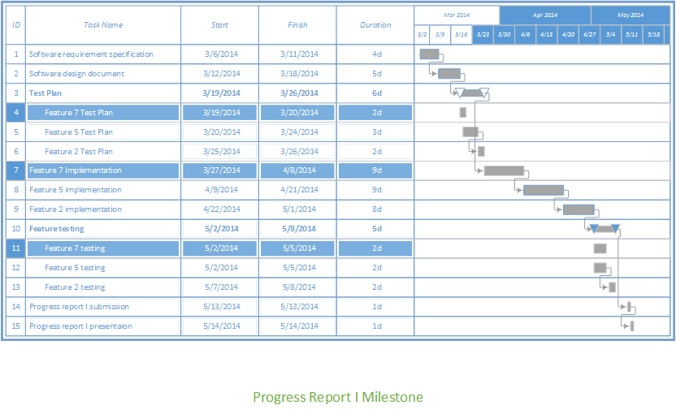
Schedule and Milestone

Slide 23
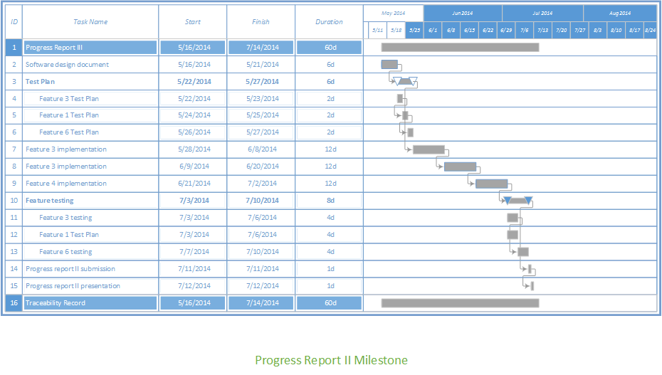
Schedule and Milestone

Slide 24
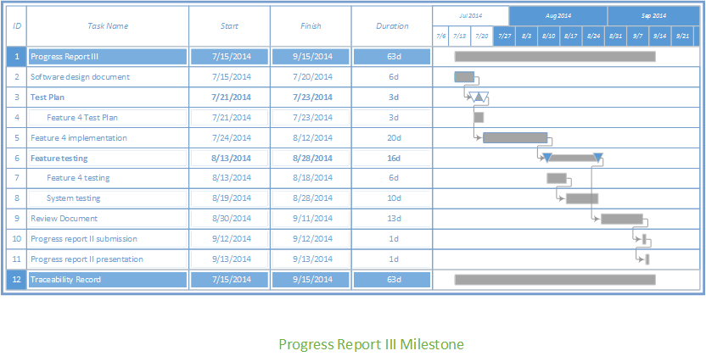
Schedule and Milestone

Slide 25
Thank you!
Q&A

